Slide 1
Extended Faculty Meeting
August 29, 2017

Slide 2
Bell Work:
Use anticipation guide for reading
SURF - Sustained Uninterrupted Reading for Fun(damentals)

Slide 3
ANNOUNCEMENTS:
Thank you AFJROTC for the traffic guidance in the morning.

Slide 4
AGENDA:
SURF
Announcements
EpiPen
EES Video
PD - Learning Targets
Star Learning Walk Pair

Slide 5
EpiPen Training
Welcome Jill Moriyama
Notes:
DeAnne

Slide 6
EES VIDEO:
https://vimeo.com/223337672
Notes:
DeAnne

Slide 7
EES VIDEO:
In your journal, what additional concerns or questions might you have regarding EES for this school year?
Notes:
DeAnne

Slide 8
LEARNING TARGETS
Understand the difference between learning and doing
Learning targets must include: Learn, Do, and Demonstrate
Understand that learning targets can be skills, processes, or concepts
Understand that learning targets may last for more than a day
Notes:
Robin
Unify outcomes in an entire unit
Learning targets guide learning and done in language that students u

Slide 9
Learning Targets: WE DO
Joanna and Barbara share examples of learning targets

Slide 10
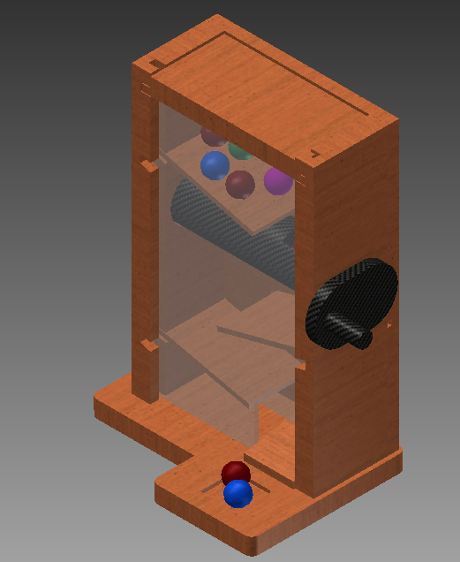
Target Consumer | Children ages 5 to 12
Problem Statement | The Candy Company is celebrating its 50th year anniversary and would like to provide consumers with a candy dispenser that will house the two existing bite-size candies that they currently produce. They also want new shapes created for each candy.
Constraints | Must be durable. Must fit into a box with interior dimensions of 3.75 in. wide x 2 in. deep x 6 in. high. Must hold two existing bite-size candy shapes and one new candy shapes. The new candy shapes cannot exceed ½ in. width, depth, height, or diameter.

Slide 11
Learning Targets
Learn
How to use specific Geometric Constraints tools
Do
* Use Inventor Software to fix geometry of different shapes

Slide 12
Learning targets for engineering design challenge
learn about STEM, design challenges, and ways that you can incorporate these strategies into your own classrooms
to bond and work together in a collaborative environment.

Slide 13
Learning Target for Expository II
Learn how to identify an Image, an Emotion, and Tone in a poem through annotation
Do Today: annotate the poem and list an image, emotion, and tone from analyzing your annotation and the annotations of your peers (I do, we do)
Demonstrate your learning by: writing a MEAT paragraph that analyzes an image, emotion, or tone (you do)

Slide 14
Learning Targets: YOU DO
Think of a recent lesson
Refine the learning target for that lesson

Slide 15
STAR WALK PAIRING:
Front of Library
Please move into groups by your prep period.
For those w/more than 1 prep, choose which period you are doing your Learning Walk.
Use this time to pick your pair.paper.
1
4
2
5
3
6
7

