Slide 1
Please help students with their soup project:
http://bit.ly/soup2016

Slide 2
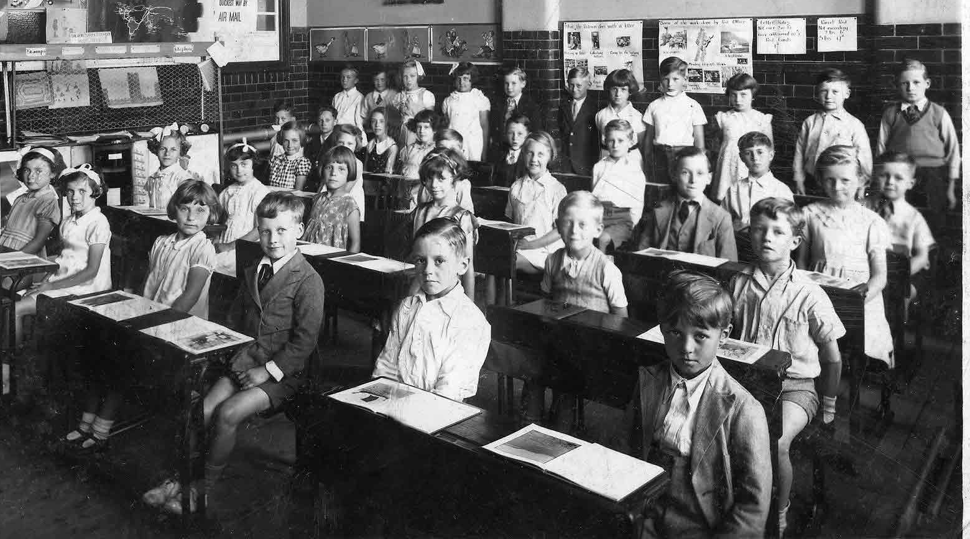
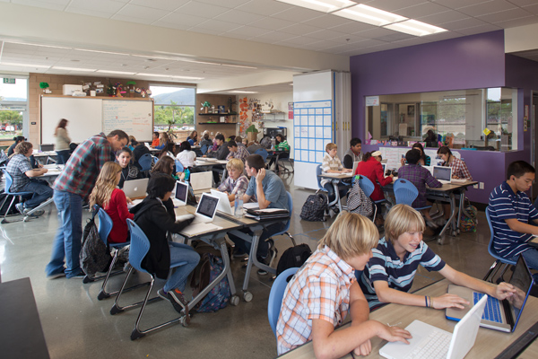
“moving toward improved teaching & learning…”

Slide 3
AGENDA:
Registration
Admin
Fire Inspection
WASC Sharing
STAR Learning Walk Reflection
IPDP PLC
Notes:
Erik

Slide 4
LEARNING TARGETS:
I can explain and describe updates on registration, WASC, & Fire Inspection.
I can explain how the STAR Learning Walks fulfill a portion of the 21 hour requirement.
Prof Dev. 11/18
I can use my Professional Growth (IPDP) PLC to discuss the implementation of my IPDP goal for the year.
Notes:
Erik

Slide 5
Registration
Dates: January 9th - January 19th
(check your LNs for other dates/RSVPs)
Goal: Create a master schedule that meets the needs of all of our students and teachers.
Notes:
Erik

Slide 6
Registration - Procedures:
Middle School Visit (w/ teachers)
December 6th - 2:30 p.m.
Please let me know if you want to arrange your own visit (with or without students)
Notes:
Erik

Slide 7
Fire Inspection
Notes:
Robin

Slide 8
WASC - Focus on Learning (FOL)
Organization
Curriculum
Instruction
Assessment
Culture and Support
Notes:
Robin

Slide 9
Notes:
Robin

Slide 10
MOVING TOWARD IMPROVED TEACHING & LEARNING
Data Teams
(Identify Priority Standards)
MOHS PD
(Training & Support)
STAR Learning Walk
(Progress & Indicators)
1) Power & Priority Standards Defined
1) Power & Priority Standards
1) Observations used to SEE Teaching & Learning, Alignment document helps define/describe Indicators
2) Instructional Strat. Modeling & Support
2) Instructional Strat.
3) REFLECTION & Professional Growth
IMPROVED TEACHING
IMPROVED LEARNING
3) REFLECTION used for NEXT STEPS towards Improvement
3) Common Formative Practice & REFLECTION
Notes:
Priscilla
These are the three (3) things that help us keep moving towards improved teaching and learning.
We want to make connections for everything that we are already doing.

Slide 11
See Talk Apply Reflect Learning Walk

Slide 12
STAR WALK ABSENCE:
Absent Teachers
Make-Up Star Walk
Make arrangements on your own
Deadline: December 9
Notes:
Barb

Slide 13
STAR WALK TEMPERATURE CHECK:
Emoji
Think-Pair-Share
I felt this way because…
Questions/Concerns
Notes:
Barb
3-4 minutes of share time

Slide 14
STAR WALK REMINDER:
Generously given 2 hours/quarter for 2nd, 3rd, and 4th quarter to do the STAR WALK as part of your 21 hour checklist (total of 6 hours)
Being done in lieu of an additional extended faculty meetings
Notes:
Contract requires: 21 hours of professional development time, for which you earn 3 PD credits. If you recall, your 21 hours are made up of ____________. The time allocated to Star Walks makes of 6 of the 21 hours of PD time. The time you spend doing your Star Walks is in lieu of additional extended faculty meetings. (3 meetings? )

Slide 15
21 Hour Checklist:
Extended Faculty Meetings (9 hrs)
STAR Learning Walk (6 hrs)
EES
New Teachers - 6 hours
All Others - 2 hours (IPDP Work) + Self Directed Prof. Growth (4 hrs)
Notes:
Missy

Slide 16
Professional Growth (IPDP) PLC
Notes:
Priscilla

Slide 17
IPDP Bell Work: Improved Teaching
I will get better at (IPDP Goal) ___________ by _________________________________.
This will impact student learning because __.
EXAMPLE:
I will get better at providing valuable feedback by
attending data teams to solidify criteria (rubric) for
formative assessments,
researching how to give clear and effective feedback.
This will impact student learning because students will understand how to improve their work.
Notes:
Missy

Slide 18
Professional Growth (IPDP) PLC Skit

Slide 19
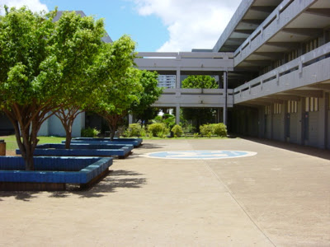
Sitting around school

Slide 20
Sitting around at Henry Loui’s

Slide 21
At Henry Loui’s Again...

Slide 22
Guiding Questions:
Our topic is...
We learned or grew by…
Changes we saw in our students were…
Success and challenges we had…
Here are some samples of implementation...
Suggested Activities:
Research/Learning
Discuss Strategies
Create Lesson Plan
Reflect: Success & Challenges
Action Research
Notes:
Priscilla - 2 minutes
-These are the guiding questions you can use in your PLC collaboration time during PD meeting
-This will also be used for your share out at the end of the year

Slide 23
IPDP Exit Pass: Improved Teaching
My take away from today's collaboration with my IPDP PLC was ____________________.
My next steps to reach my IPDP goals are ___________________ .
Notes:
Priscilla

Slide 24
THANK YOU!
Have a great day!

Slide 25
IPDP (Professional Growth) PLC Groups
This PLC was created to help you with the implementation of your IPDP goal
IPDP → (Another word for professional development)
We used to do professional development more extensively, but topics were forced on us
FAD of the year - (i.e RRR, Tribes, Critical Friends)
No group support - you did it on your own
Accountability – used to be a journal entry or presentation at the PD Conference
Notes:
Alan

Slide 26
IPDP (Professional Growth) PLC Groups
BUT NOW...
IPDP → (Another word for professional development)
PERSONALIZED - you pick what you want to work on
NOT A FAD - you decide what you want to get better at (and it maybe something you are already doing)
PLCs (IPDP, STAR Learning Walk, & Data Team) - Provide opportunities for support and reflection
Accountability - EES and Teacher Union (21 hour checklist) Requirements
Notes:
Only for PD Notes - not an actual slide

